Slide 1
Numpy And Pandas
By - Shreyansh Chheda

Slide 2
Numpy

Slide 3
What is NumPy?
Numpy is a Python Module for working with Arrays
NumPy stands for Numerical Python
NumPy is used to perform mathematical operations on Arrays
The core of NumPy is a powerful optimized C Code
NumPy is an open-source library

Slide 4
What is the purpose of NumPy?
Numpy is not a programming language, it is a Python Extension whose purpose is to provide functions and capability to transform arrays. Following are the purpose of Working with Numpy:
Smaller Memory Consumption than List
Implementation of Multi-Dimensional Arrays
NumPy arrays are faster than Python List
NumPy can be used to transform the Arrays
Python does not have inbuilt support for Arrays
Offers function like Reshape, Sort, Reverse, etc.

Slide 5
How do I get NumPy?
In order to install Numpy Package, we need to use the following command:
pip install numpy

Slide 6
Why NumPy is faster than the list?
Numpy array is much faster for Mathematical Operation in Array-like data.
NumPy Array is collection of Homogeneous data whereas the List is a Heterogeneous collection of data
NumPy Array saves data in continuous memory location making it easier to iterate through the data and making the operation less expensive.
NumPy can break the array execution in sub-parts and then each of this subpart can be executed parallelly in the system to improve the speed
NumPy is based out of C, C++ which has a lower execution time

Slide 7
What is NumPy?
Numpy is a Python Module for working with Arrays
NumPy stands for Numerical Python
NumPy is used to perform mathematical operations on Arrays
The core of NumPy is a powerful optimized C Code
NumPy is an open-source library

Slide 8
Numpy Functions for Machine Learning
Common features and functions that can be used in machine learning for transforming the input data.
Creating a Numpy Array
Reshaping Array Dimensions
Slicing NumPy Arrays
Joining NumPy Arrays
Sorting Arrays in NumPy

Slide 9
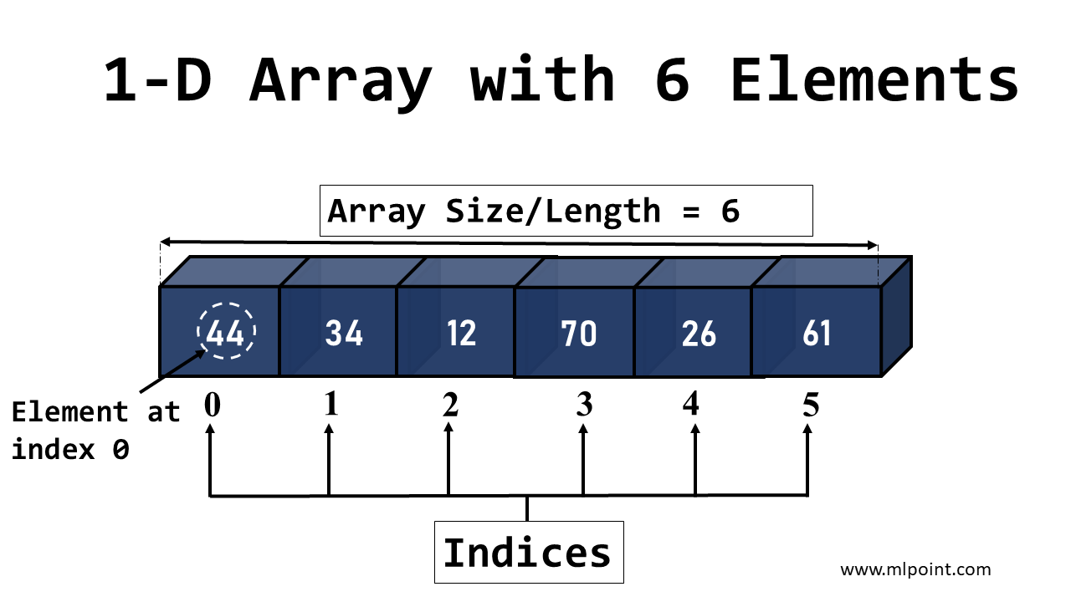

Slide 10
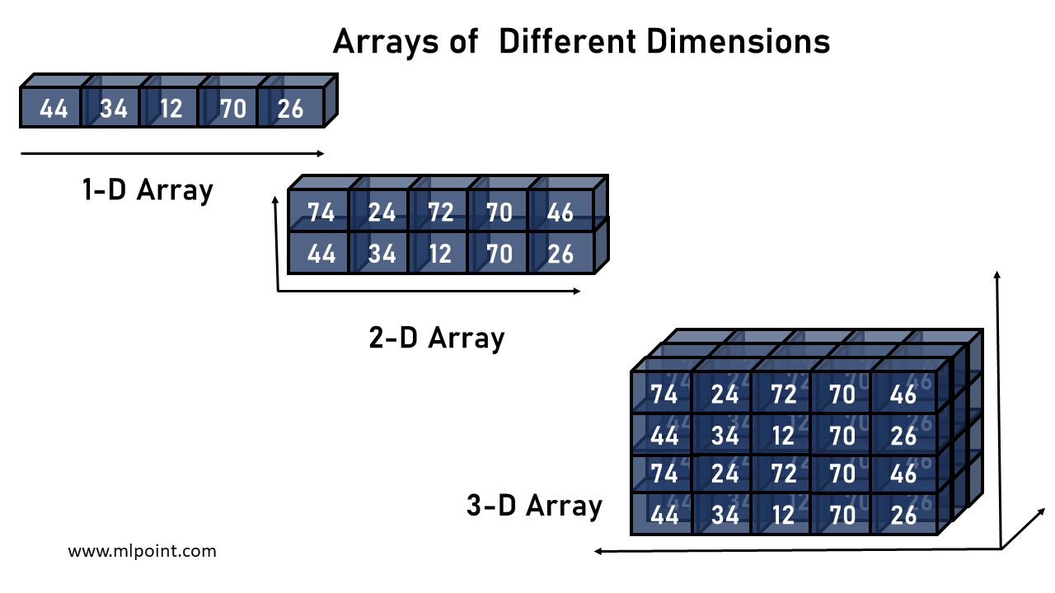

Slide 11
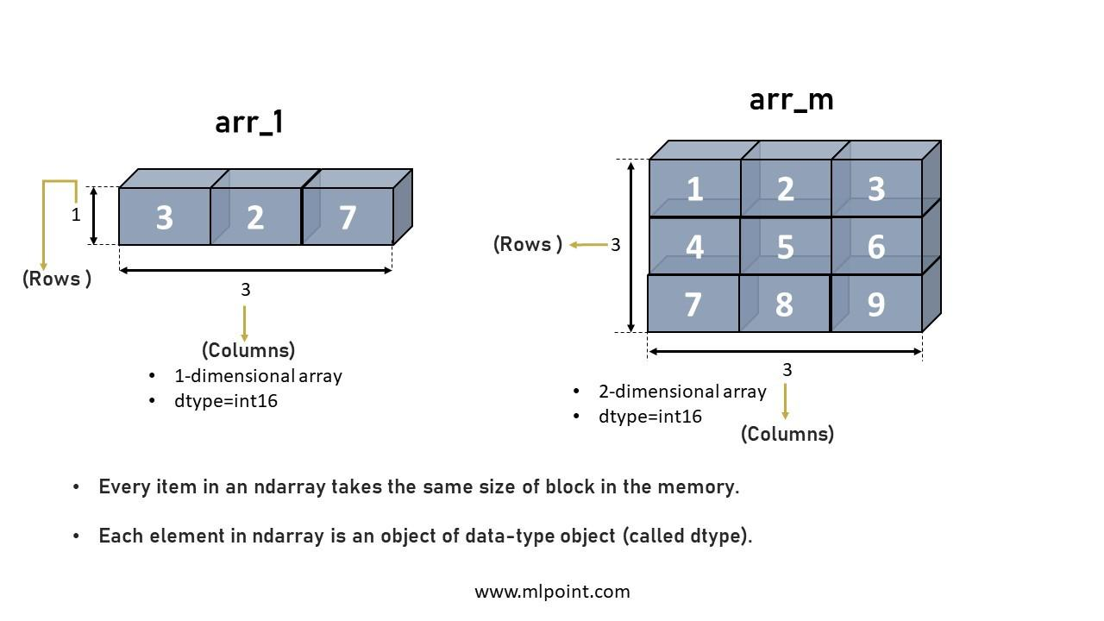

Slide 12
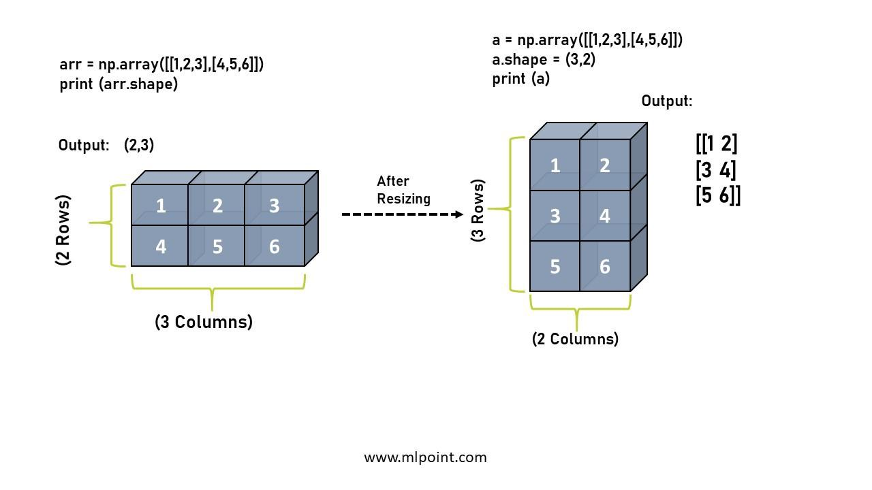

Slide 13
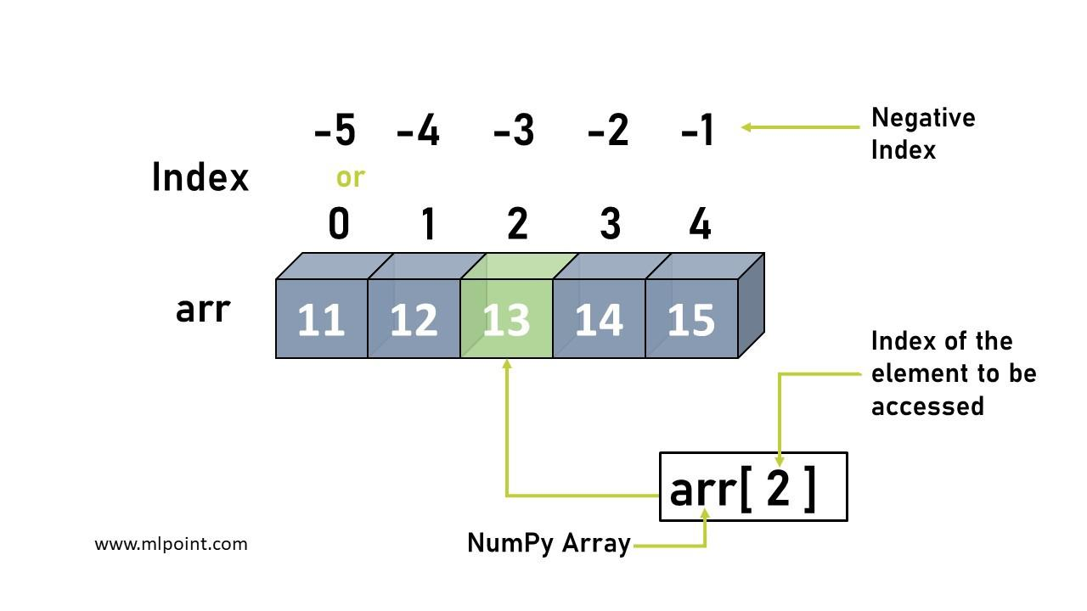

Slide 14
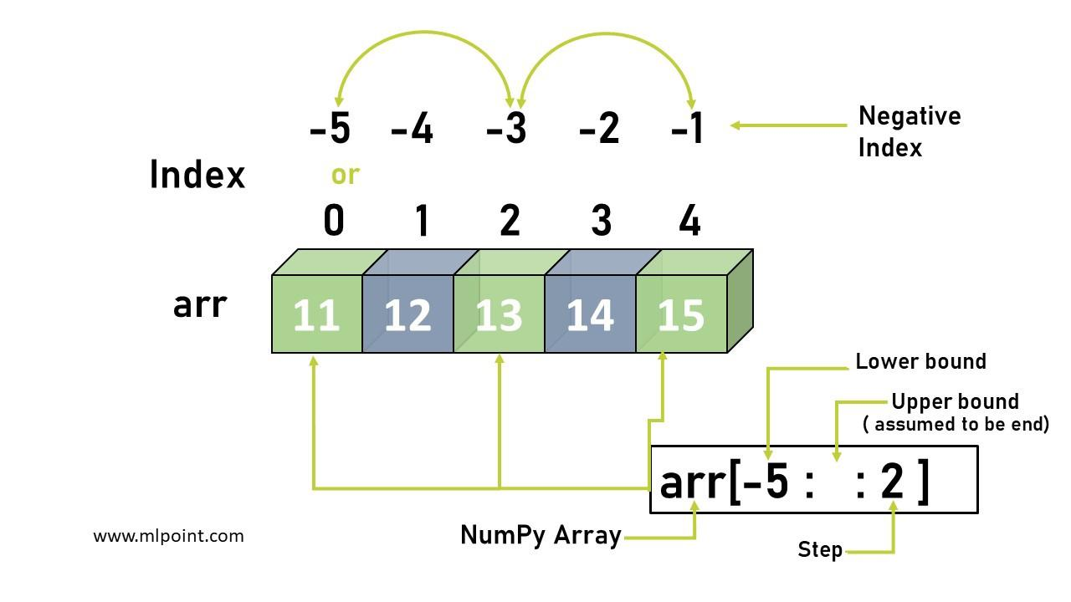

Slide 15
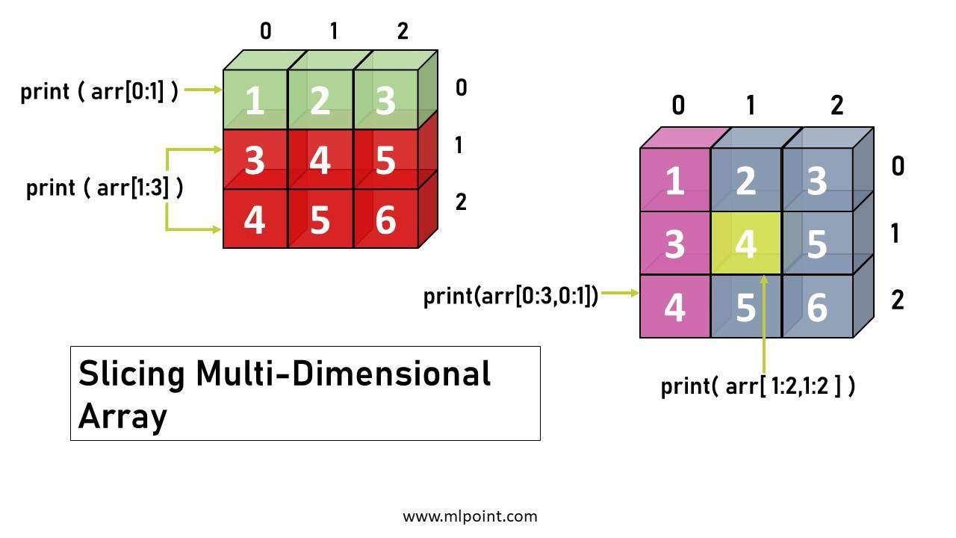

Slide 16
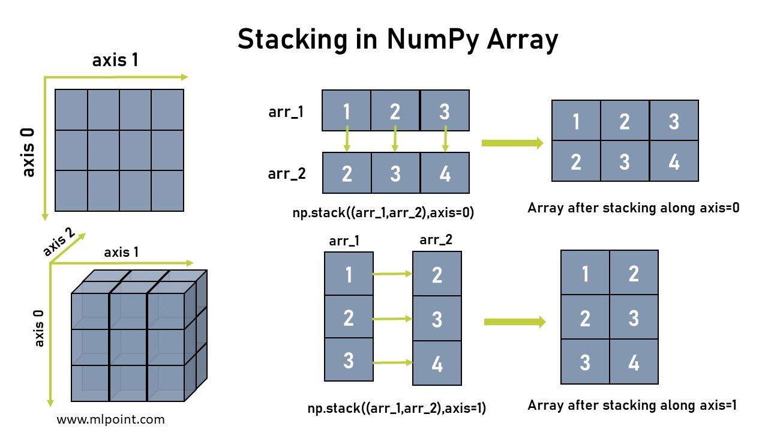

Slide 17
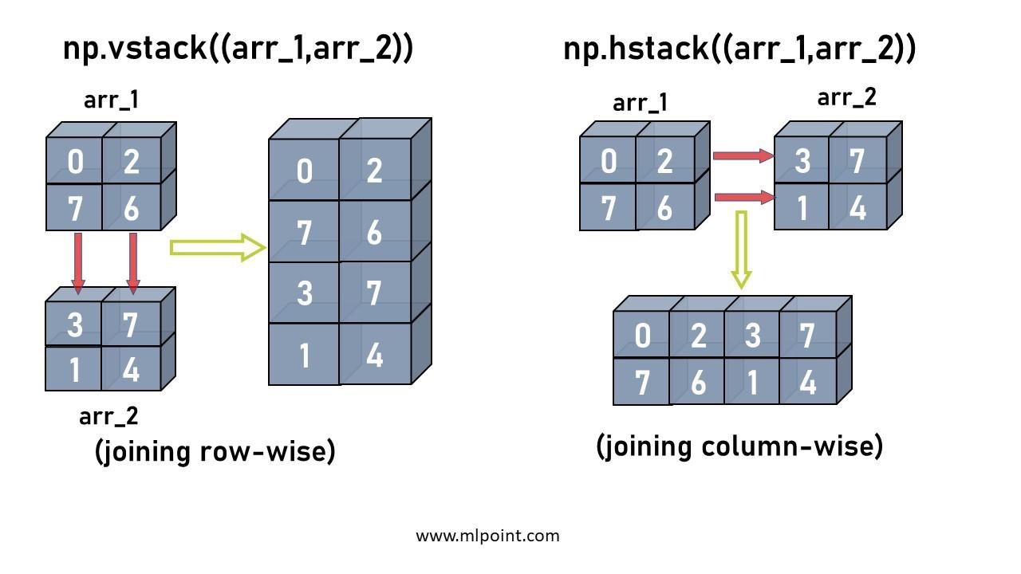

Slide 18
Pandas

Slide 19
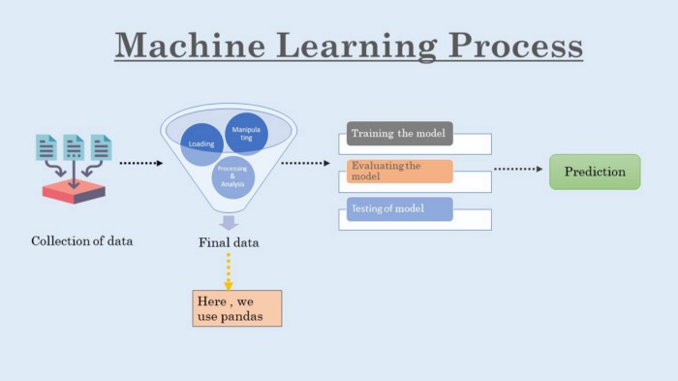

Slide 20
Introduction to Pandas
Pandas is an open-source python package built on top of Numpy It is used as one of the most important data cleaning and analysis tool. It provides fast, flexible, and expressive data structures.
Pandas is derived from the term “Panel-data-s” an econometrics term for data sets include observations over multiple time periods for the same individuals. -source Wikipedia

Slide 21
2. How to install and import Pandas?
You can install Pandas by using the following commands:
pip install pandas
# or
conda install pandas
You can import pandas using the following command
import pandas as pd

Slide 22
Pandas Data Structures
Pandas deals with three types of data structures :
Series
DataFrame
Panel

Slide 23
a)Series is a one-dimensional array-like structure with homogeneous data. The size of the series is immutable(cannot be changed) but its values are mutable.

Slide 24
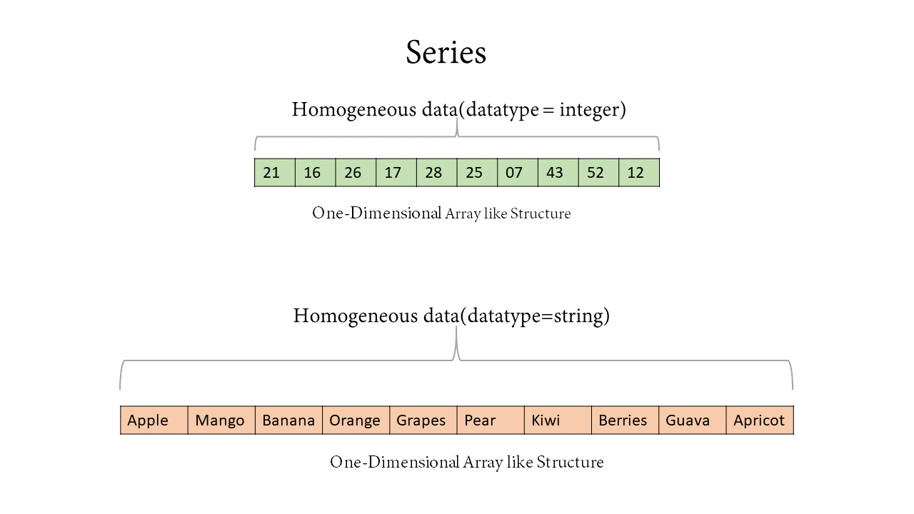

Slide 25
b) DataFrame is a two-dimensional array-like structure with heterogeneous data. Data is aligned in a tabular manner(Rows & Columns form). The size and values of DataFrame are mutable.

Slide 26
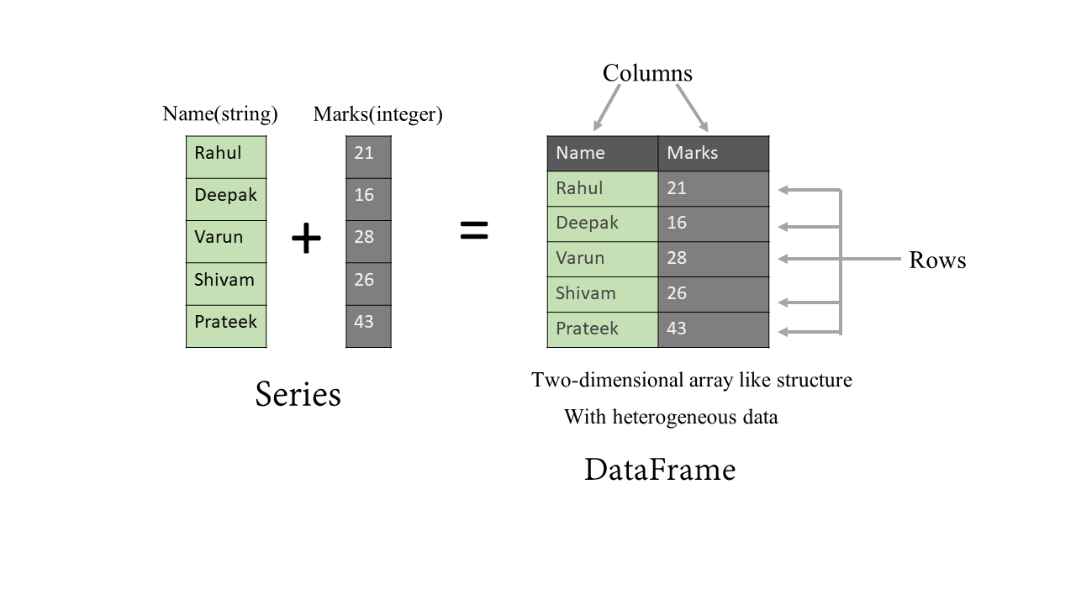

Slide 27
c) The panel is a three-dimensional data structure with heterogeneous data. The size and values of a Panel are mutable.

Slide 28
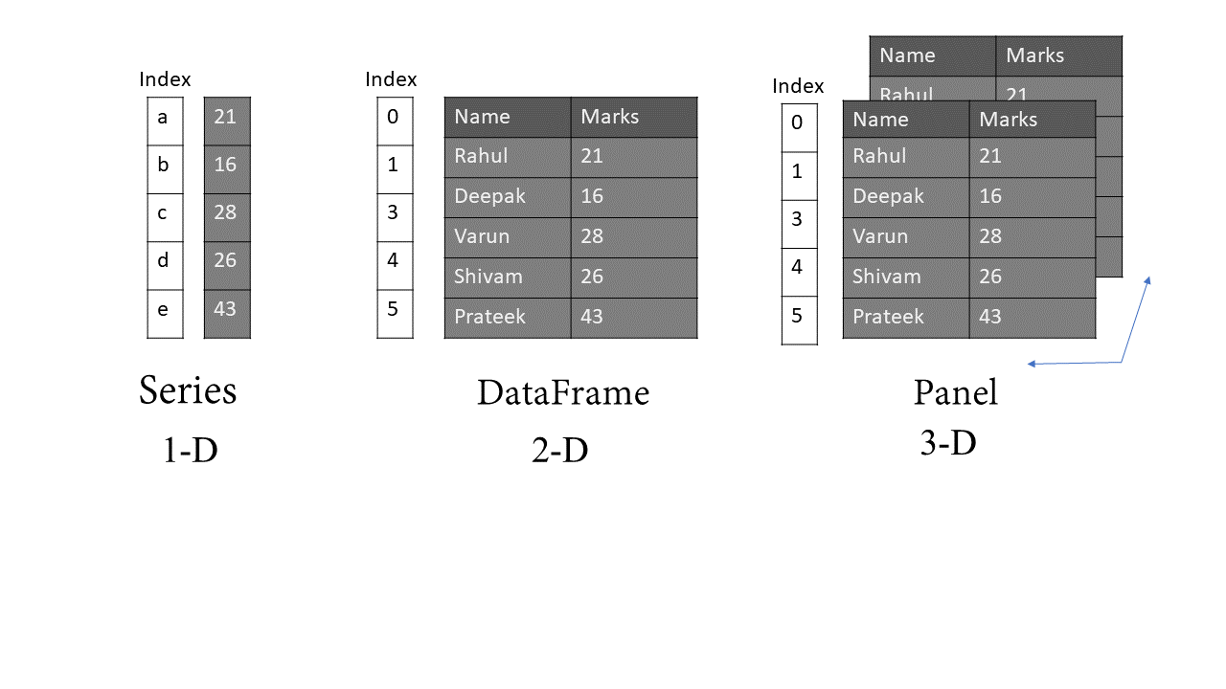

Slide 29
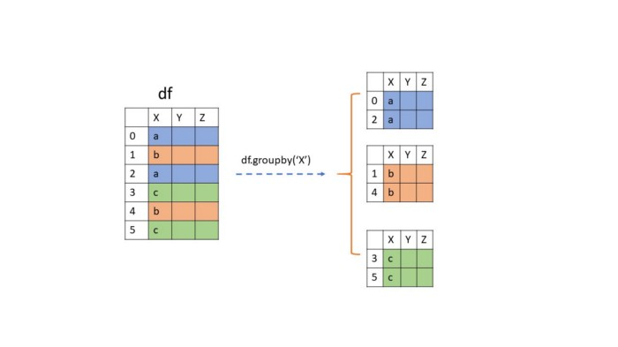

Slide 30
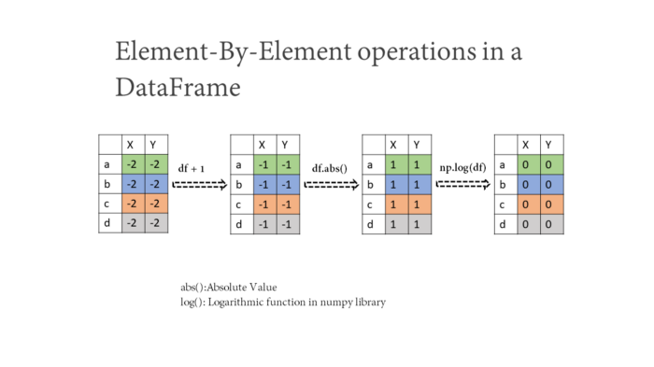

Slide 31
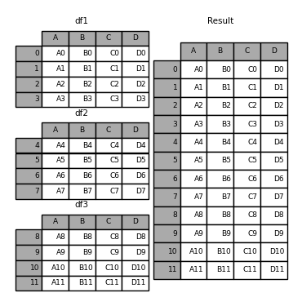

Slide 32
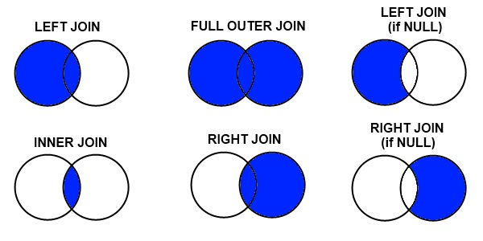

Slide 33
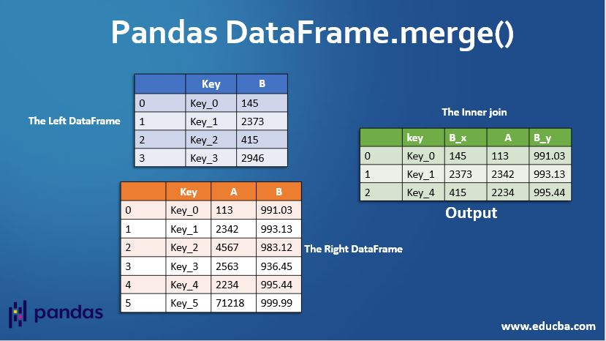

Slide 34
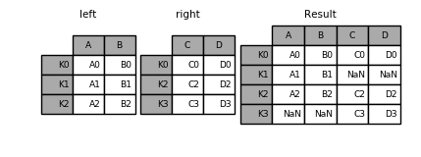

Slide 35
